Slide 1
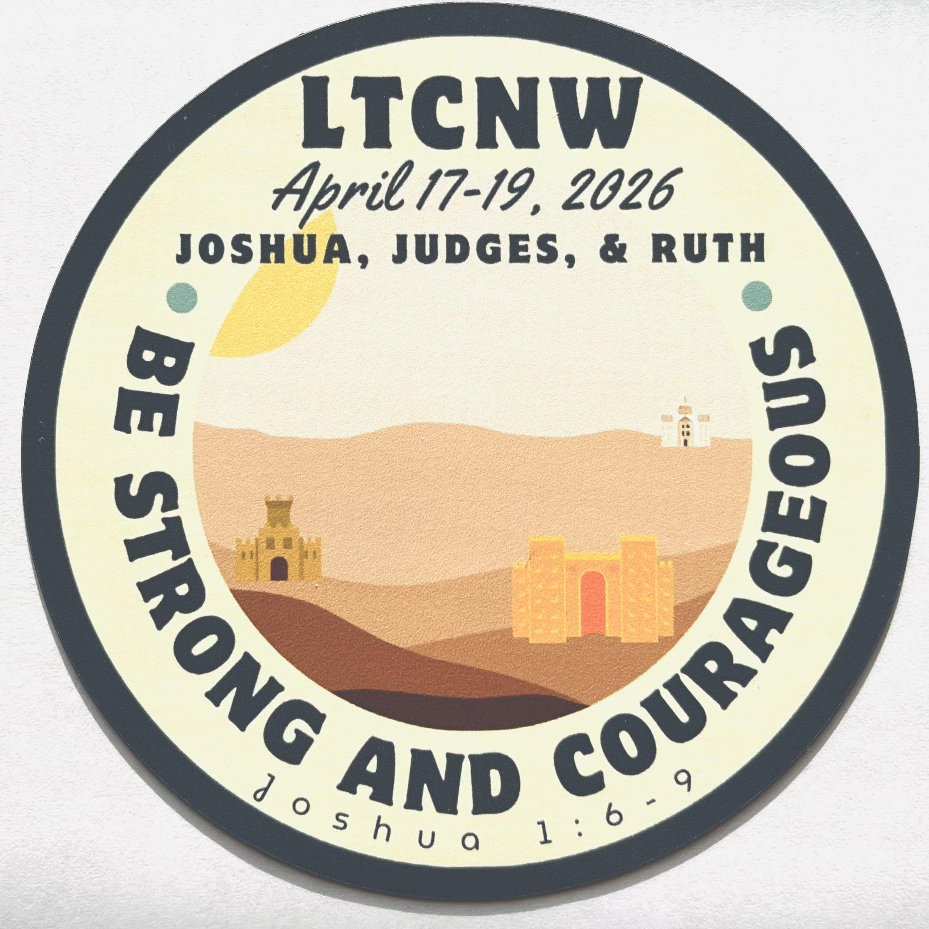
LTCNW
BE STRONG AND COURAGEOUS
01
Reading Log
Copy and save this slideshow in your google drive. Use it to take notes on your phone as you read through Joshua, Judges, and Ruth.
Date started
MM.DD.YY
Date completed
MM.DD.YY
LTCNW
JOSHUA 1-12
02
LTCNW
JOSHUA 13-24
03
LTCNW
JUDGES 1-10
04
LTCNW
JUDGES 11-21
05
LTCNW
RUTH
06
LTCNW
SYNTHESIS
07
LTCNW
THEME
08

Slide 2
LTCNW
BE STRONG AND COURAGEOUS
01
LTCNW
JOSHUA 1-12
02
1
1-9
God Commissions Joshua
One thing I learned is that…
10-18
Joshua Assumes Command
One thing I learned is that…
This chapter is about…
One question I have is…
LTCNW
JOSHUA 13-24
03
LTCNW
JUDGES 1-10
04
LTCNW
JUDGES 11-21
05
LTCNW
RUTH
06
LTCNW
SYNTHESIS
07
LTCNW
THEME
08

Slide 3
LTCNW
BE STRONG AND COURAGEOUS
01
LTCNW
JOSHUA 1-12
02
Joshua
1:6-9
[type out verses here, then highlight important words]
LTCNW
JOSHUA 13-24
03
LTCNW
JUDGES 1-10
04
LTCNW
JUDGES 11-21
05
LTCNW
RUTH
06
LTCNW
SYNTHESIS
07
LTCNW
THEME
08

Slide 4
LTCNW
BE STRONG AND COURAGEOUS
01
LTCNW
JOSHUA 1-12
02
2
1-24
Rahab Hides
the Spies
One thing I learned is that…
This chapter is about…
3
1-17
Israel Crosses
the Jordan
One thing I learned is that…
This chapter is about…
Crossing the Jordan is [similar to/different than] crossing the Red Sea because…
LTCNW
JOSHUA 13-24
03
LTCNW
JUDGES 1-10
04
LTCNW
JUDGES 11-21
05
LTCNW
RUTH
06
LTCNW
SYNTHESIS
07
LTCNW
THEME
08

Slide 5
LTCNW
BE STRONG AND COURAGEOUS
01
LTCNW
JOSHUA 1-12
02
4
1-24
Twelve Memorial Stones from the Jordan
One thing I learned is that…
This chapter is about…
Add a confusing word or phrase. Double click to edit.
a word or phrase
i don't understand
Look up the definition using the interlinear/concordance (blue letter bible)
and/or
Look up the word in a student dictionary
LTCNW
JOSHUA 13-24
03
LTCNW
JUDGES 1-10
04
LTCNW
JUDGES 11-21
05
LTCNW
RUTH
06
LTCNW
SYNTHESIS
07
LTCNW
THEME
08

Slide 6
LTCNW
BE STRONG AND COURAGEOUS
01
LTCNW
JOSHUA 1-12
02
5
1-9
The New Generation Circumcised
One thing I learned is that…
10-12
First Passover
in Canaan
One thing I learned is that…
13-15
The Commander of the Lord’s Army
One thing I learned is that…
This chapter is about…
One question I have is…
LTCNW
JOSHUA 13-24
03
LTCNW
JUDGES 1-10
04
LTCNW
JUDGES 11-21
05
LTCNW
RUTH
06
LTCNW
SYNTHESIS
07
LTCNW
THEME
08

Slide 7
LTCNW
BE STRONG AND COURAGEOUS
01
LTCNW
JOSHUA 1-12
02
a city
or place
Describe a place that you have read about in this section.
Add a map or a picture which illustrates the place you have described..
Cite where the place is found in Joshua
LTCNW
JOSHUA 13-24
03
LTCNW
JUDGES 1-10
04
LTCNW
JUDGES 11-21
05
LTCNW
RUTH
06
LTCNW
SYNTHESIS
07
LTCNW
THEME
08

Slide 8
LTCNW
BE STRONG AND COURAGEOUS
01
LTCNW
JOSHUA 1-12
02
6
1-27
The Fall
of Jericho
One thing I learned is that…
This chapter is about…
7
1-9
Israel Defeated
at Ai
One thing I learned is that…
10-26
The Sin of Achan
One thing I learned is that…
How did Achan sin?
LTCNW
JOSHUA 13-24
03
LTCNW
JUDGES 1-10
04
LTCNW
JUDGES 11-21
05
LTCNW
RUTH
06
LTCNW
SYNTHESIS
07
LTCNW
THEME
08

Slide 9
LTCNW
BE STRONG AND COURAGEOUS
01
LTCNW
JOSHUA 1-12
02
8
1-29
The Fall of Ai
One thing I learned is that…
30-35
Joshua Renews the Covenant
One thing I learned is that…
This chapter is about…
One question I have is…
LTCNW
JOSHUA 13-24
03
LTCNW
JUDGES 1-10
04
LTCNW
JUDGES 11-21
05
LTCNW
RUTH
06
LTCNW
SYNTHESIS
07
LTCNW
THEME
08

Slide 10
LTCNW
BE STRONG AND COURAGEOUS
01
LTCNW
JOSHUA 1-12
02
9
1-27
The Gibeonite Deception
One thing I learned is that…
This chapter is about…
Add a picture which illustrates one of the narratives you have read.
Cite the story
LTCNW
JOSHUA 13-24
03
LTCNW
JUDGES 1-10
04
LTCNW
JUDGES 11-21
05
LTCNW
RUTH
06
LTCNW
SYNTHESIS
07
LTCNW
THEME
08

Slide 11
LTCNW
BE STRONG AND COURAGEOUS
01
LTCNW
JOSHUA 1-12
02
10
1-15
The Sun
Stands Still
Something I noticed is…
16-28
Five Amorite Kings Executed
29-43
Conquest of Southern Canaan
This chapter is about…
One question I have is…
LTCNW
JOSHUA 13-24
03
LTCNW
JUDGES 1-10
04
LTCNW
JUDGES 11-21
05
LTCNW
RUTH
06
LTCNW
SYNTHESIS
07
LTCNW
THEME
08

Slide 12
LTCNW
BE STRONG AND COURAGEOUS
01
LTCNW
JOSHUA 1-12
02
11
1-23
Conquests in Northern Canaan
One thing I learned is that…
This chapter is about…
12
1-6
Kings Defeated
by Moses
One thing I learned is that…
7-24
Kings Defeated
by Joshua
Names or places I recognized in Chapter 12:
LTCNW
JOSHUA 13-24
03
LTCNW
JUDGES 1-10
04
LTCNW
JUDGES 11-21
05
LTCNW
RUTH
06
LTCNW
SYNTHESIS
07
LTCNW
THEME
08

Slide 13
LTCNW
BE STRONG AND COURAGEOUS
01
LTCNW
JOSHUA 1-12
02
name
List details about a main character you have read about in the text.
Detail 1
Detail 2
Detail 3
List Pros and Cons of the main characters actions and characteristics.
GOOD | BAD
The author wants you to view the [Main Character] as [Good/Bad] because they…
LTCNW
JOSHUA 13-24
03
LTCNW
JUDGES 1-10
04
LTCNW
JUDGES 11-21
05
LTCNW
RUTH
06
LTCNW
SYNTHESIS
07
LTCNW
THEME
08

Slide 14
LTCNW
BE STRONG AND COURAGEOUS
01
LTCNW
JOSHUA 1-12
02
LTCNW
JOSHUA 13-24
03
13
1-7
Land Still to
Be Conquered
While I was reading I noticed that…
8-32
The Inheritance East of the Jordan
This chapter is about…
Why didn’t the tribe of Levi receive land as inheritance?
LTCNW
JUDGES 1-10
04
LTCNW
JUDGES 11-21
05
LTCNW
RUTH
06
LTCNW
SYNTHESIS
07
LTCNW
THEME
08

Slide 15
LTCNW
BE STRONG AND COURAGEOUS
01
LTCNW
JOSHUA 1-12
02
LTCNW
JOSHUA 13-24
03
14
1-5
The Inheritance West of the Jordan
One thing I learned is that…
6-15
Caleb’s Request and Inheritance
One thing I learned is that…
This chapter is about…
What significant role do the Anakim play in Israel’s past and future? Cite and explain 2 reasons.
LTCNW
JUDGES 1-10
04
LTCNW
JUDGES 11-21
05
LTCNW
RUTH
06
LTCNW
SYNTHESIS
07
LTCNW
THEME
08

Slide 16
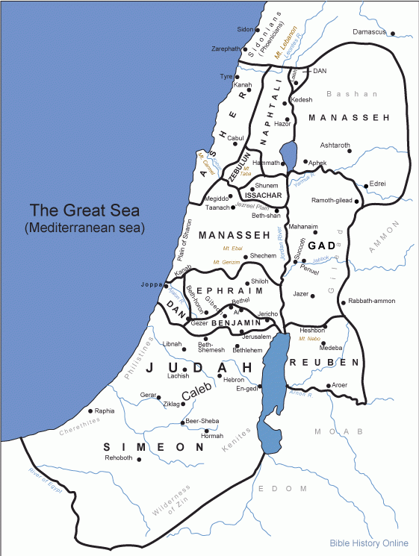
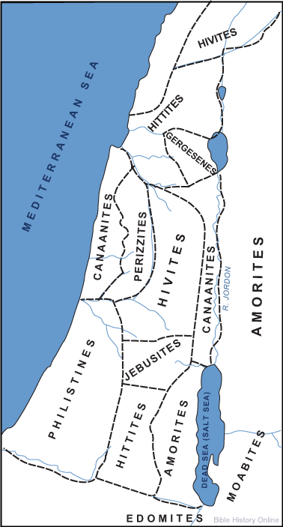
LTCNW
BE STRONG AND COURAGEOUS
01
LTCNW
JOSHUA 1-12
02
LTCNW
JOSHUA 13-24
03
15
1-63
The Allotment
for Judah
One thing I learned is that…
The map shows who had possession of the land which God was giving to the Israelites. Draw and label Judah’s portion on the map.
Key:
LTCNW
JUDGES 1-10
04
LTCNW
JUDGES 11-21
05
LTCNW
RUTH
06
LTCNW
SYNTHESIS
07
LTCNW
THEME
08

Slide 17
LTCNW
BE STRONG AND COURAGEOUS
01
LTCNW
JOSHUA 1-12
02
LTCNW
JOSHUA 13-24
03
16
1-10
The Allotment
for Ephraim and Manasseh
One thing I learned is that…
17
1-18
18
1-10
Allotment of the
Remaining Land
One thing I learned is that…
11-28
The Inheritance for Benjamin
One thing I learned is that…
Edit Map on slide 15: Draw and label the land borders for these tribes on the map.
LTCNW
JUDGES 1-10
04
LTCNW
JUDGES 11-21
05
LTCNW
RUTH
06
LTCNW
SYNTHESIS
07
LTCNW
THEME
08

Slide 18
LTCNW
BE STRONG AND COURAGEOUS
01
LTCNW
JOSHUA 1-12
02
LTCNW
JOSHUA 13-24
03
19
1-9
The Inheritance for Simeon
Something I noticed is that…
10-16
The Inheritance for Zebulun
17-23
The Inheritance for Issachar
24-31
The Inheritance for Asher
32-39
The Inheritance for Naphtali
40-48
The Inheritance for Dan
49-51
The Inheritance for Joshua
Edit Map on slide 15: Draw and label the land borders for these tribes on the map.
LTCNW
JUDGES 1-10
04
LTCNW
JUDGES 11-21
05
LTCNW
RUTH
06
LTCNW
SYNTHESIS
07
LTCNW
THEME
08

Slide 19
LTCNW
BE STRONG AND COURAGEOUS
01
LTCNW
JOSHUA 1-12
02
LTCNW
JOSHUA 13-24
03
12 Sons
of Jacob
12 Tribes
of Israel
Son
Son
Son
Tribe
Tribe
Tribe
Highlight the sons/tribes which received a land inheritance.
LTCNW
JUDGES 1-10
04
LTCNW
JUDGES 11-21
05
LTCNW
RUTH
06
LTCNW
SYNTHESIS
07
LTCNW
THEME
08

Slide 20
LTCNW
BE STRONG AND COURAGEOUS
01
LTCNW
JOSHUA 1-12
02
LTCNW
JOSHUA 13-24
03
20
1-9
The Cities
of Refuge
One thing I learned is that…
This chapter is about…
21
1-45
Cities and Pasturelands Allotted to Levi
One thing I learned is that…
This chapter is about…
What purpose did the cities of refuge serve?
LTCNW
JUDGES 1-10
04
LTCNW
JUDGES 11-21
05
LTCNW
RUTH
06
LTCNW
SYNTHESIS
07
LTCNW
THEME
08

Slide 21
LTCNW
BE STRONG AND COURAGEOUS
01
LTCNW
JOSHUA 1-12
02
LTCNW
JOSHUA 13-24
03
Joshua
21:44-45
[type out verses here, then highlight important words]
LTCNW
JUDGES 1-10
04
LTCNW
JUDGES 11-21
05
LTCNW
RUTH
06
LTCNW
SYNTHESIS
07
LTCNW
THEME
08

Slide 22
LTCNW
BE STRONG AND COURAGEOUS
01
LTCNW
JOSHUA 1-12
02
LTCNW
JOSHUA 13-24
03
a city
or place
Describe a place that you have read about in this section.
Add a picture which illustrates the place you have described..
Cite where the place is found in Joshua
LTCNW
JUDGES 1-10
04
LTCNW
JUDGES 11-21
05
LTCNW
RUTH
06
LTCNW
SYNTHESIS
07
LTCNW
THEME
08

Slide 23
LTCNW
BE STRONG AND COURAGEOUS
01
LTCNW
JOSHUA 1-12
02
LTCNW
JOSHUA 13-24
03
22
1-9
The Eastern Tribes Return Home
One thing I learned is that…
10-34
The Eastern Tribes’ Altar
of Witness
One thing I learned is that…
This chapter is about…
Add a confusing word or phrase. Double click to edit.
a word or phrase
Look up the definition using the interlinear/concordance (blue letter bible)
and/or
Look up the word in a student dictionary
LTCNW
JUDGES 1-10
04
LTCNW
JUDGES 11-21
05
LTCNW
RUTH
06
LTCNW
SYNTHESIS
07
LTCNW
THEME
08

Slide 24
LTCNW
BE STRONG AND COURAGEOUS
01
LTCNW
JOSHUA 1-12
02
LTCNW
JOSHUA 13-24
03
23
1-16
Joshua’s Charge to Israel’s Leaders
One thing I learned is that…
This chapter is about…
24
1-13
The Covenant Renewal at Shecham
One thing I learned is that…
14-28
Choose Whom You Will Serve
29-33
Joshua’s Death and Burial
This chapter is about…
LTCNW
JUDGES 1-10
04
LTCNW
JUDGES 11-21
05
LTCNW
RUTH
06
LTCNW
SYNTHESIS
07
LTCNW
THEME
08

Slide 25
LTCNW
BE STRONG AND COURAGEOUS
01
LTCNW
JOSHUA 1-12
02
LTCNW
JOSHUA 13-24
03
Joshua
24:14-15
[type out verses here, then highlight important words]
LTCNW
JUDGES 1-10
04
LTCNW
JUDGES 11-21
05
LTCNW
RUTH
06
LTCNW
SYNTHESIS
07
LTCNW
THEME
08

Slide 26
LTCNW
BE STRONG AND COURAGEOUS
01
LTCNW
JOSHUA 1-12
02
LTCNW
JOSHUA 13-24
03
LTCNW
JUDGES 1-10
04
1
1-26
The Continuing Conquest of Canaan
One thing I learned is that…
27-36
Failure to Complete the Conquest
One thing I learned is that…
This chapter is about…
One question I have is…
LTCNW
JUDGES 11-21
05
LTCNW
RUTH
06
LTCNW
SYNTHESIS
07
LTCNW
THEME
08

Slide 27
LTCNW
BE STRONG AND COURAGEOUS
01
LTCNW
JOSHUA 1-12
02
LTCNW
JOSHUA 13-24
03
LTCNW
JUDGES 1-10
04
Judges
2:11-12
[type out verses here, then highlight important words]
LTCNW
JUDGES 11-21
05
LTCNW
RUTH
06
LTCNW
SYNTHESIS
07
LTCNW
THEME
08

Slide 28
LTCNW
BE STRONG AND COURAGEOUS
01
LTCNW
JOSHUA 1-12
02
LTCNW
JOSHUA 13-24
03
LTCNW
JUDGES 1-10
04
2
1-5
Israel’s Disobedience
This chapter is about…
6-10
The Death of Joshua
11-15
Israel’s Unfaithfulness
16-23
The Lord Raises up Judges
While I was reading, I noticed…
3
1-6
LTCNW
JUDGES 11-21
05
LTCNW
RUTH
06
LTCNW
SYNTHESIS
07
LTCNW
THEME
08

Slide 29
LTCNW
BE STRONG AND COURAGEOUS
01
LTCNW
JOSHUA 1-12
02
LTCNW
JOSHUA 13-24
03
LTCNW
JUDGES 1-10
04
3
7-11
Othniel
Detail 1
Detail 2
Detail 3
name
12-30
Ehud
Detail 1
Detail 2
Detail 3
name
31
Shamgar
Detail 1
Detail 2
Detail 3
name
LTCNW
JUDGES 11-21
05
LTCNW
RUTH
06
LTCNW
SYNTHESIS
07
LTCNW
THEME
08

Slide 30
LTCNW
BE STRONG AND COURAGEOUS
01
LTCNW
JOSHUA 1-12
02
LTCNW
JOSHUA 13-24
03
LTCNW
JUDGES 1-10
04
4
1-24
Deborah and Barak
One question I have is…
5
1-31
The Song of Deborah and Barak
Detail 1
Detail 2
Detail 3
name
Detail 1
Detail 2
Detail 3
name
LTCNW
JUDGES 11-21
05
LTCNW
RUTH
06
LTCNW
SYNTHESIS
07
LTCNW
THEME
08

Slide 31
LTCNW
BE STRONG AND COURAGEOUS
01
LTCNW
JOSHUA 1-12
02
LTCNW
JOSHUA 13-24
03
LTCNW
JUDGES 1-10
04
6
1-10
Midian Oppresses Israel
How has Midian played a role in the history of the Israelites?
11-27
The Call of Gideon
28-35
Gideon Destroys the Altar of Baal
36-40
The Sign of the Fleece
This chapter is about…
Detail 1
Detail 2
Detail 3
name
LTCNW
JUDGES 11-21
05
LTCNW
RUTH
06
LTCNW
SYNTHESIS
07
LTCNW
THEME
08

Slide 32
LTCNW
BE STRONG AND COURAGEOUS
01
LTCNW
JOSHUA 1-12
02
LTCNW
JOSHUA 13-24
03
LTCNW
JUDGES 1-10
04
7
1-18
Gideon’s Three Hundred Men
This chapter is about…
19-25
Gideon Defeats Midian
8
1-21
Gideon Defeats Zebah and Zalmunna
This chapter is about…
22-28
Gideon’s Ephod
29-35
The Death of Gideon
How is a “Judge” in this book different than a judge today?
LTCNW
JUDGES 11-21
05
LTCNW
RUTH
06
LTCNW
SYNTHESIS
07
LTCNW
THEME
08

Slide 33
LTCNW
BE STRONG AND COURAGEOUS
01
LTCNW
JOSHUA 1-12
02
LTCNW
JOSHUA 13-24
03
LTCNW
JUDGES 1-10
04
Judges
6:12
[type out verses here, then highlight important words]
LTCNW
JUDGES 11-21
05
LTCNW
RUTH
06
LTCNW
SYNTHESIS
07
LTCNW
THEME
08

Slide 34
LTCNW
BE STRONG AND COURAGEOUS
01
LTCNW
JOSHUA 1-12
02
LTCNW
JOSHUA 13-24
03
LTCNW
JUDGES 1-10
04
9
1-21
Abimelech’s Conspiracy
This chapter is about…
22-57
The Downfall of Abimelech
10
1-5
Tola and Jair
Detail 1
Detail 2
Detail 3
name
name
Detail 1
Detail 2
Detail 3
6-18
Further Disobedience and Oppression
I noticed…
LTCNW
JUDGES 11-21
05
LTCNW
RUTH
06
LTCNW
SYNTHESIS
07
LTCNW
THEME
08

Slide 35
LTCNW
BE STRONG AND COURAGEOUS
01
LTCNW
JOSHUA 1-12
02
LTCNW
JOSHUA 13-24
03
LTCNW
JUDGES 1-10
04
LTCNW
JUDGES 11-21
05
11
1-28
Jephthah
Delivers Israel
One question I have is…
29-40
Jephthah’s
Tragic Vow
12
Jephthah’s Conflict with Ephraim
Detail 1
Detail 2
Detail 3
This passage is about…
name
LTCNW
RUTH
06
LTCNW
SYNTHESIS
07
LTCNW
THEME
08

Slide 36
LTCNW
BE STRONG AND COURAGEOUS
01
LTCNW
JOSHUA 1-12
02
LTCNW
JOSHUA 13-24
03
LTCNW
JUDGES 1-10
04
LTCNW
JUDGES 11-21
05
12
8-15
Ibzan, Elon,
and Abdon
Detail 1
Detail 2
Detail 3
name
Detail 1
Detail 2
Detail 3
name
name
Detail 1
Detail 2
Detail 3
Add a confusing word or phrase. Double click to edit.
a word or phrase
Look up the definition using the interlinear/concordance (blue letter bible)
and/or
Look up the word in a student dictionary
LTCNW
RUTH
06
LTCNW
SYNTHESIS
07
LTCNW
THEME
08

Slide 37
LTCNW
BE STRONG AND COURAGEOUS
01
LTCNW
JOSHUA 1-12
02
LTCNW
JOSHUA 13-24
03
LTCNW
JUDGES 1-10
04
LTCNW
JUDGES 11-21
05
13
1-25
The Birth of Samson
One question I have is…
14
1-20
Samson’s Marriage
15
1-20
Samson’s Defeats the Philistines
Detail 1
Detail 2
Detail 3
16
1-22
Samson and Delilah
23-31
The Death of Samson
name
LTCNW
RUTH
06
LTCNW
SYNTHESIS
07
LTCNW
THEME
08

Slide 38
LTCNW
BE STRONG AND COURAGEOUS
01
LTCNW
JOSHUA 1-12
02
LTCNW
JOSHUA 13-24
03
LTCNW
JUDGES 1-10
04
LTCNW
JUDGES 11-21
05
17
1-13
Micah and the Levite
One question I have is…
18
1-31
Danites take the Levite and the Idol
These chapters show that…
19
1-21
A Levite and
His Concubine
22-30
Gibeah’s Crime
LTCNW
RUTH
06
LTCNW
SYNTHESIS
07
LTCNW
THEME
08

Slide 39
LTCNW
BE STRONG AND COURAGEOUS
01
LTCNW
JOSHUA 1-12
02
LTCNW
JOSHUA 13-24
03
LTCNW
JUDGES 1-10
04
LTCNW
JUDGES 11-21
05
20
1-48
Israel’s War with the Tribe of Benjamin
One thing I learned is that…
21
1-25
Wives Provided for the Tribe of Benjamin
This chapter shows that…
Describe 2 ways that the Israelites do not follow God in this book. Cite sources.
LTCNW
RUTH
06
LTCNW
SYNTHESIS
07
LTCNW
THEME
08

Slide 40
LTCNW
BE STRONG AND COURAGEOUS
01
LTCNW
JOSHUA 1-12
02
LTCNW
JOSHUA 13-24
03
LTCNW
JUDGES 1-10
04
LTCNW
JUDGES 11-21
05
Judges
21:25
[type out verses here, then highlight important words]
LTCNW
RUTH
06
LTCNW
SYNTHESIS
07
LTCNW
THEME
08

Slide 41
LTCNW
BE STRONG AND COURAGEOUS
01
LTCNW
JOSHUA 1-12
02
LTCNW
JOSHUA 13-24
03
LTCNW
JUDGES 1-10
04
LTCNW
JUDGES 11-21
05
LTCNW
RUTH
06
1
1-5
Naomi Widowed
One thing I learned is that…
6-18
Ruth’s Loyalty
to Naomi
19-22
Naomi and Ruth Return
This chapter is about…
One question I have is…
LTCNW
SYNTHESIS
07
LTCNW
THEME
08

Slide 42
LTCNW
BE STRONG AND COURAGEOUS
01
LTCNW
JOSHUA 1-12
02
LTCNW
JOSHUA 13-24
03
LTCNW
JUDGES 1-10
04
LTCNW
JUDGES 11-21
05
LTCNW
RUTH
06
Ruth
1:16-17
[type out verses here, then highlight important words]
LTCNW
SYNTHESIS
07
LTCNW
THEME
08

Slide 43
LTCNW
BE STRONG AND COURAGEOUS
01
LTCNW
JOSHUA 1-12
02
LTCNW
JOSHUA 13-24
03
LTCNW
JUDGES 1-10
04
LTCNW
JUDGES 11-21
05
LTCNW
RUTH
06
The map shows the israelite inheritance boundaries. Draw and label the cities and areas from Ruth 1.
Key
2
1-23
Ruth Meets Boaz
One thing I learned is that…
3
1-18
Ruth and Boaz at the Threshing Floor
LTCNW
SYNTHESIS
07
LTCNW
THEME
08

Slide 44
LTCNW
BE STRONG AND COURAGEOUS
01
LTCNW
JOSHUA 1-12
02
LTCNW
JOSHUA 13-24
03
LTCNW
JUDGES 1-10
04
LTCNW
JUDGES 11-21
05
LTCNW
RUTH
06
name
List details about a main character you have read about in the text.
Detail 1
Detail 2
Detail 3
List Pros and Cons of the main characters actions and characteristics.
GOOD | BAD
The author wants you to view the [Main Character] as [Good/Bad] because they…
LTCNW
SYNTHESIS
07
LTCNW
THEME
08

Slide 45
LTCNW
BE STRONG AND COURAGEOUS
01
LTCNW
JOSHUA 1-12
02
LTCNW
JOSHUA 13-24
03
LTCNW
JUDGES 1-10
04
LTCNW
JUDGES 11-21
05
LTCNW
RUTH
06
4
1-12
Boaz Redeems Ruth
One thing I learned is that…
13-17
Ruth and Boaz Marry
18-22
The Genealogy
of David
This chapter is about…
What significance does this Genealogy have to the future of the Israelites?
LTCNW
SYNTHESIS
07
LTCNW
THEME
08

Slide 46
LTCNW
BE STRONG AND COURAGEOUS
01
LTCNW
JOSHUA 1-12
02
LTCNW
JOSHUA 13-24
03
LTCNW
JUDGES 1-10
04
LTCNW
JUDGES 11-21
05
LTCNW
RUTH
06
LTCNW
SYNTHESIS
07
Joshua
The book of Joshua is about [_________]. One detail that supports my main point is [_________], because [_________]. Another reason I think this is because [_________].
[_________] is the main character in the book, we know this because [_________].
I also think the book shows us that God is [_________].
The most interesting narrative to me was [_________]. I liked it because [_________].
LTCNW
THEME
08

Slide 47
LTCNW
BE STRONG AND COURAGEOUS
01
LTCNW
JOSHUA 1-12
02
LTCNW
JOSHUA 13-24
03
LTCNW
JUDGES 1-10
04
LTCNW
JUDGES 11-21
05
LTCNW
RUTH
06
LTCNW
SYNTHESIS
07
Judges
The book of Judges is about [_________]. One detail that supports my main point is [_________], because [_________]. Another reason I think this is because [_________].
[_________] is one of the main characters in the book, we know this because [_________].
I also think the book shows us that God is [_________].
The most interesting narrative to me was [_________]. I liked it because [_________].
LTCNW
THEME
08

Slide 48
LTCNW
BE STRONG AND COURAGEOUS
01
LTCNW
JOSHUA 1-12
02
LTCNW
JOSHUA 13-24
03
LTCNW
JUDGES 1-10
04
LTCNW
JUDGES 11-21
05
LTCNW
RUTH
06
LTCNW
SYNTHESIS
07
Ruth
The book of Ruth is about [_________]. One detail that supports my main point is [_________], because [_________]. Another reason I think this is because [_________].
[_________] is one of the main characters in the book, we know this because [_________].
I also think the book shows us that God is [_________].
The most interesting narrative to me was [_________]. I liked it because [_________].
LTCNW
THEME
08

Slide 49
LTCNW
BE STRONG AND COURAGEOUS
01
LTCNW
JOSHUA 1-12
02
LTCNW
JOSHUA 13-24
03
LTCNW
JUDGES 1-10
04
LTCNW
JUDGES 11-21
05
LTCNW
RUTH
06
LTCNW
SYNTHESIS
07
LTCNW
THEME
08
be strong and
courageous
To be strong and courageous means [_________]. One detail that supports this from the reading is [_________], because [_________]. Another reason I think this is because [_________].
In these books [_________] main characters [are/are not] strong and courageous, we know this because [_________].
I also think the book shows us that God [_________].
The narrative that connects to the theme most is [_________]. I think this because [_________].

